Slide 1
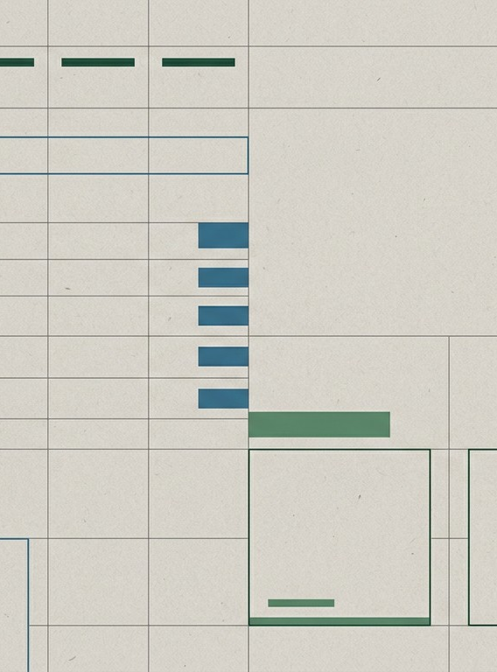
Usability Testing: Craigslist
Evaluating User Experience, Navigation Issues, and Design Insights
UX Case Study Presentation

Slide 2
Purpose of the Study
Why we tested Craigslist and what we aimed to discover.
1
2
3
Evaluate Intuitiveness
Assess how intuitive the core interface is for both new and returning users.
Observe Behaviors
Track organic navigation, search patterns, and listing interactions.
Identify Friction
Pinpoint primary areas of confusion, dead ends, or cognitive overload.

Slide 3
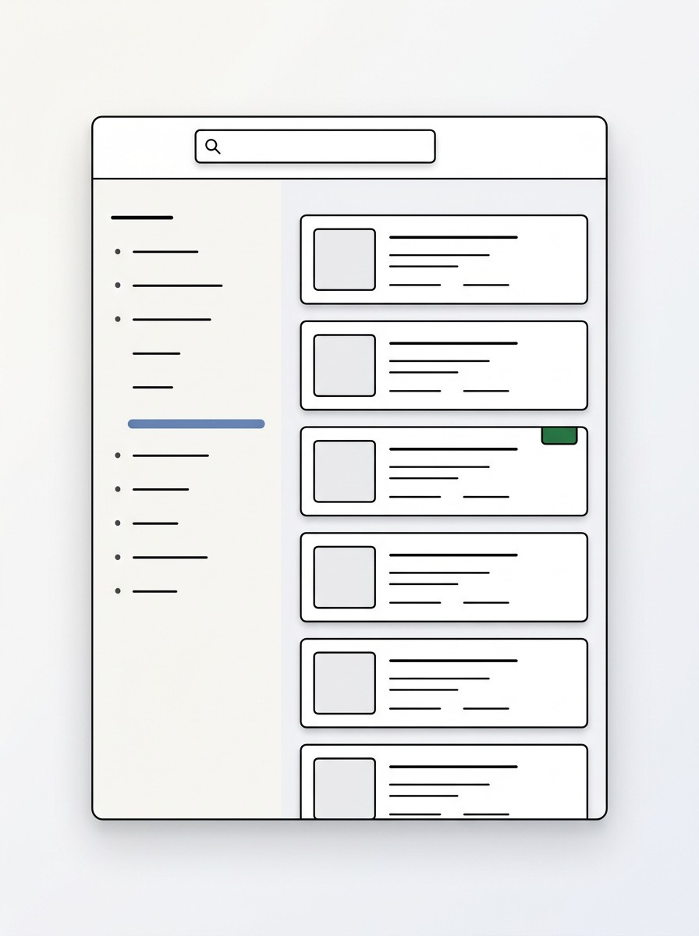
Test Participants
The Users
Graham (Student) & Sydnie (English Major)
Baseline Familiarity Highly familiar with modern online platforms (e.g., Facebook Marketplace, Amazon). Very comfortable with standard e-commerce UI patterns.
Craigslist Experience Limited prior experience specifically with the Craigslist interface.
Key Insight Their expectations are heavily shaped by contemporary, visual-first marketplace designs.

Slide 4
Testing Methodology
Conducted 2 Sessions
Moderated usability testing with Graham and Sydnie.
Users completed a set of scenario-based tasks.
Guided Tasks
Think-Aloud Protocol
Captured real-time reactions and decision-making logic.
Compared results between a leading vs. non-leading script.
Script Comparison

Slide 5
The User Journey (Tasks)
Task 5 Create a post Begin the listing creation process.
Task 4 Contact seller Find and initiate communication.
Task 3 Evaluate listing Assess credibility and item details.
Task 2 Narrow search Use filters or category navigation.
Task 1 Find an item Locate a specific item to purchase.

Slide 6
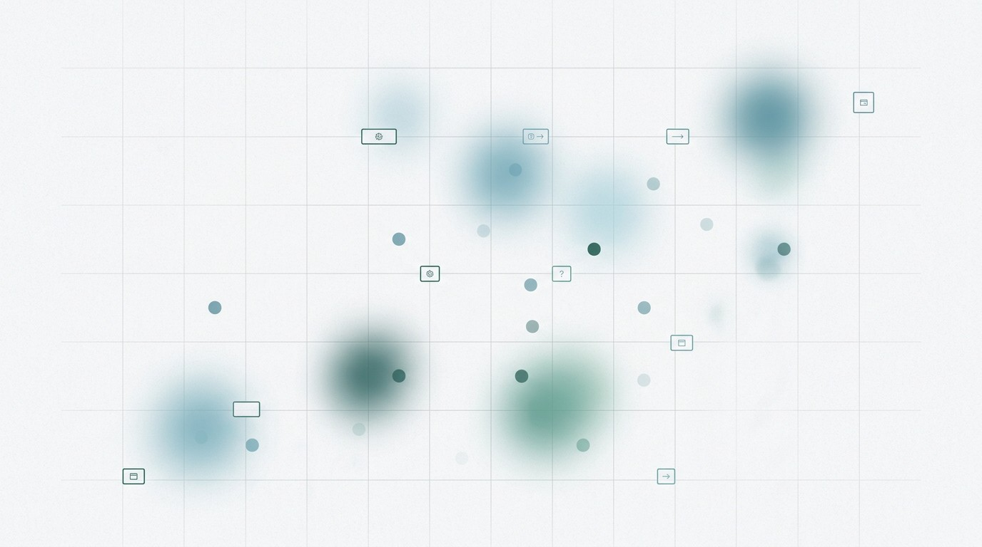
Key Findings
Homepage Friction Users experienced noticeable hesitation upon reaching the text-heavy homepage.
Unclear Navigation Categorization and primary navigation paths were not immediately obvious.
Unintuitive Filters The filtering system lacked modern UI affordances expected by users.
Unstructured Listings Individual listings felt disorganized and difficult to scan quickly.
Trust Deficit Listings without accompanying images were immediately perceived as "sketchy."

Slide 7
Observed Behavior Patterns
1
Visual Preference Users strongly preferred modern, image-first interfaces over text-dense pages.
2
Scanning Behavior Participants relied on rapid scanning rather than reading dense text to find information.
3
Missing Hierarchy The lack of clear visual hierarchy directly caused navigational confusion and hesitation.
4
Transferred Expectations Users continuously applied mental models from other platforms (e.g., Facebook Marketplace).

Slide 8
Script Comparison
VS
Graham Initial Script (Leading Questions)
Sydnie Revised Script (Non-leading Questions)
NAVIGATION
Navigated with relative ease and confidence.
Exhibited significantly more exploration.
HESITATION
Minimal hesitation during tasks.
Frequent hesitation and uncertainty observed.
Takeaway: Prompt phrasing and leading questions likely influenced the apparent ease of use in the first test.

Slide 9
Simplicity ≠ Usability A visually sparse interface does not automatically equal an intuitive one.
Design Takeaways
Core principles derived from observed user behavior.
Cognitive Load The absence of standard visual cues forces users to work harder to find information.
Design Patterns Matter Familiar, predictable UI patterns are critical for a smooth, frictionless user experience.
Trust Signals Images are not just decorative; they are essential trust signals in peer-to-peer marketplaces.

Slide 10
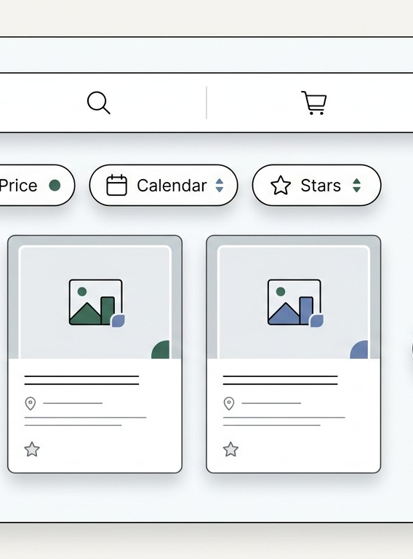
Recommended UX Improvements
Navigation Structure Implement a clearer, more prominent top-level navigation.
Visual Hierarchy Establish strong typography and spacing to guide the eye.
Image Inclusions Enforce or strongly encourage image uploads for all listings.
Clear Actions Make primary CTAs (e.g., contacting the seller) visually distinct.

Slide 11
Final Reflection
“Real users behave differently than expected. Usability testing reliably surfaces critical issues that remain invisible to designers.”
Furthermore, the phrasing of testing questions can unintentionally bias user behavior. Objective observation is key to discovering the truth about an interface.
Thank You

